Slide 1


Neutrino Oscillation
Mar 10, 2023 NeutrinoNet, NTHU Physics AI
Yuan-Yen Peng, Siang-Yuan Lin
PHYS591000 Hands-on Artificial Intelligence for Physics
National Tsing Hua University (NTHU)
Hsinchu, Taiwan
Notes:
Mistakes:
Preliminary Simulation sample in reco

Slide 2
Outline
Introduction
Theoretical Background
Experiments
Methodology
Data exploration and inspired models
Discussion
A preliminary evaluation on our models
Summary
Outlook of our own model

Slide 3
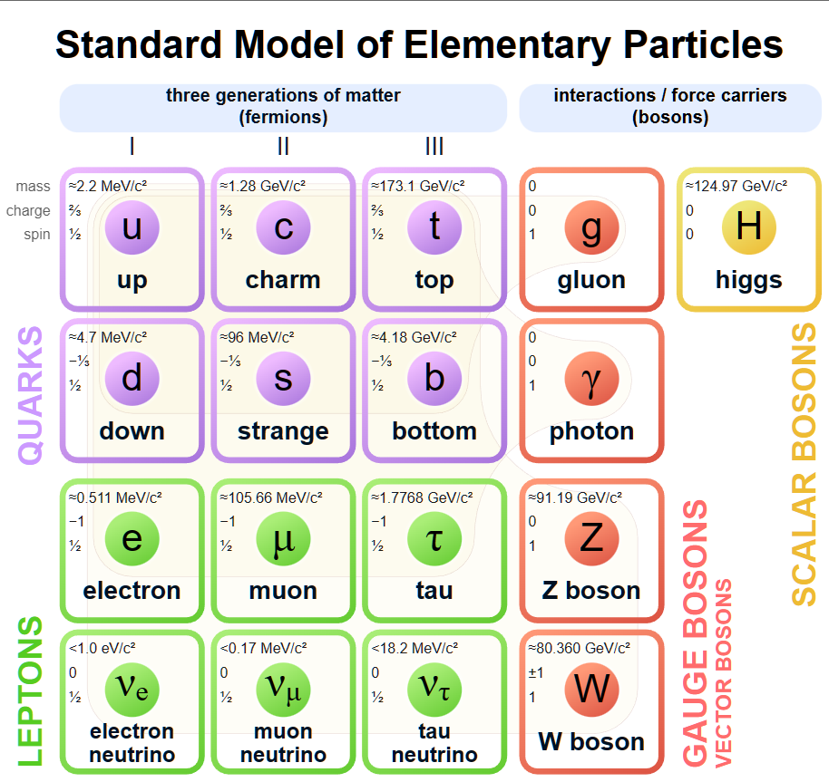
What are neutrinos?
Fermion: spin-½
Lepton: no strong interaction
Charge neutral
Where do they come from?
Weak interactions
Nuclear decays
Nuclear reactions:
fusion, spallation, etc.
Source: Wikipedia

Slide 4
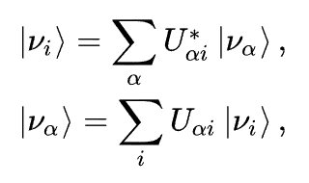
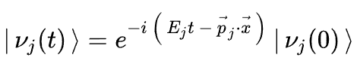
What is oscillating?
Mass Eigenstates:
The eigenstates to the free Hamiltonian are mass eigenstates
Flavor Eigenstates:
The eigenstates to the interaction Hamiltonian are flavor eigenstates
Superposition:
The standard model neutrinos are theorized to be a superposition of mass eigenstates
Time evolution:
A. Donini, M.B. Gavela, P. Hernández, S. Rigolin, Neutrino mixing and CP-violation, Nuclear Physics B. 574 (2000) 23–42. https://doi.org/10.1016/S0550-3213(00)00029-8.

Slide 5
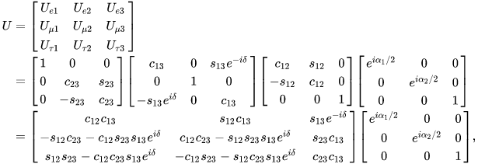
How does it oscillate?
The Pontecorvo–Maki–Nakagawa–Sakata (PMNS) Matrix
The unitary transformation between the flavor and mass eigenstates can be determined with 4 parameters. θ₁₂, θ₁₃, θ₂₃, and δ_{CP}
With this information, we can calculate the interference between waves. Given a sufficient amount of time, the phase difference becomes measurable. Long baseline experiments are designed to observe this phenomenon.

Slide 6
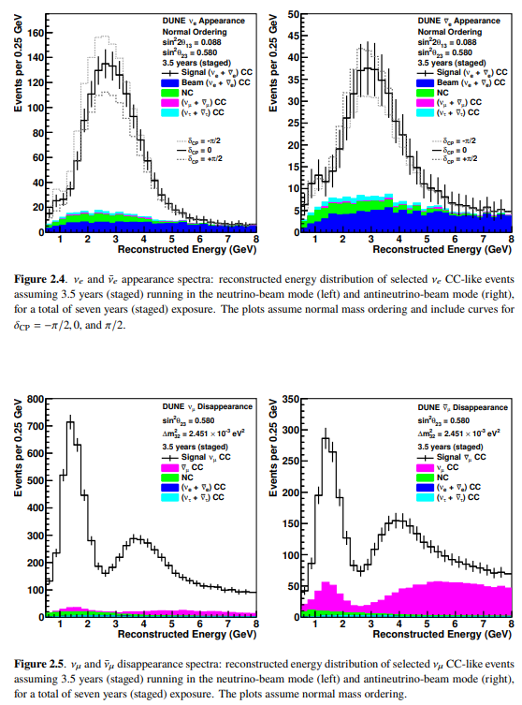
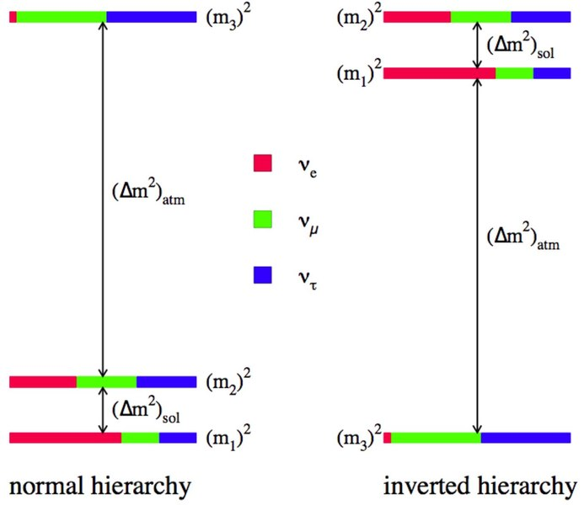
The mass hierarchy and measurements
Source: DUNE FD TDR vol 1
As we know, the quantum states is not affected by some overall phase, it is the relative phase that matters. Which is why we are only able to know the difference but not the ordering.
Source: Wikipedia

Slide 7
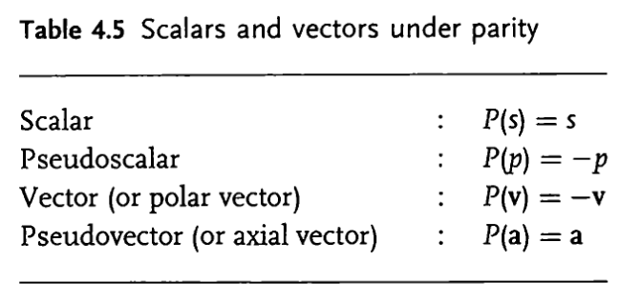
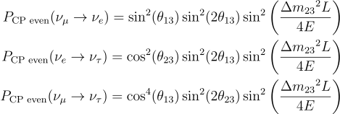
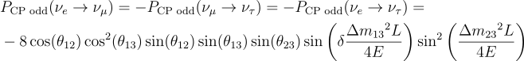
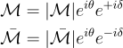
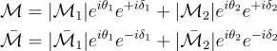
Probability and symmetry
Equations for transition probabilities:
Transition Amplitudes: If a phase is picked up from the PMNS matrix, the interference terms will cause difference between the squared amplitude.

Slide 8
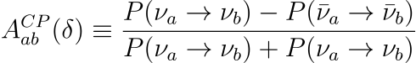
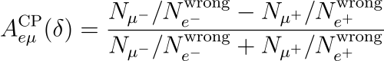
What is being measured?
The experiment aims to probe the effects of neutrino oscillations and CP violation measurements. Consider the CP asymmetry observable:
In practice, this observable is constructed from the integrated spectrum of decaying leptons N_{ℓ±} and wrong-sign leptons N_{wrongℓ±}

Slide 9
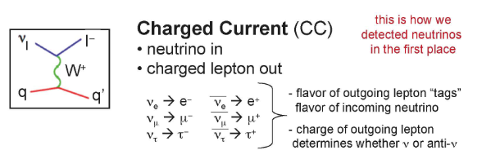
How is it measured?
Appearance Experiments:
Measure transitions between different neutrino flavors. If the final flavor to be searched for in the detector is not present in the initial beam, it could be evidence of oscillation.
Disappearance Experiments
Measure the survival probability of a neutrino by comparing the number of interactions in the detector with expected value.
Wrong-sign leptons: (an Example)
In a muon μ⁺ decay process μ⁺→𝑒⁺ν_{e}ν_{μ} , as the neutrino charged current interactions produce μ⁻, termed as a wrong-sign muon.
Source: NNPSS-TSI lecture slides

Slide 10
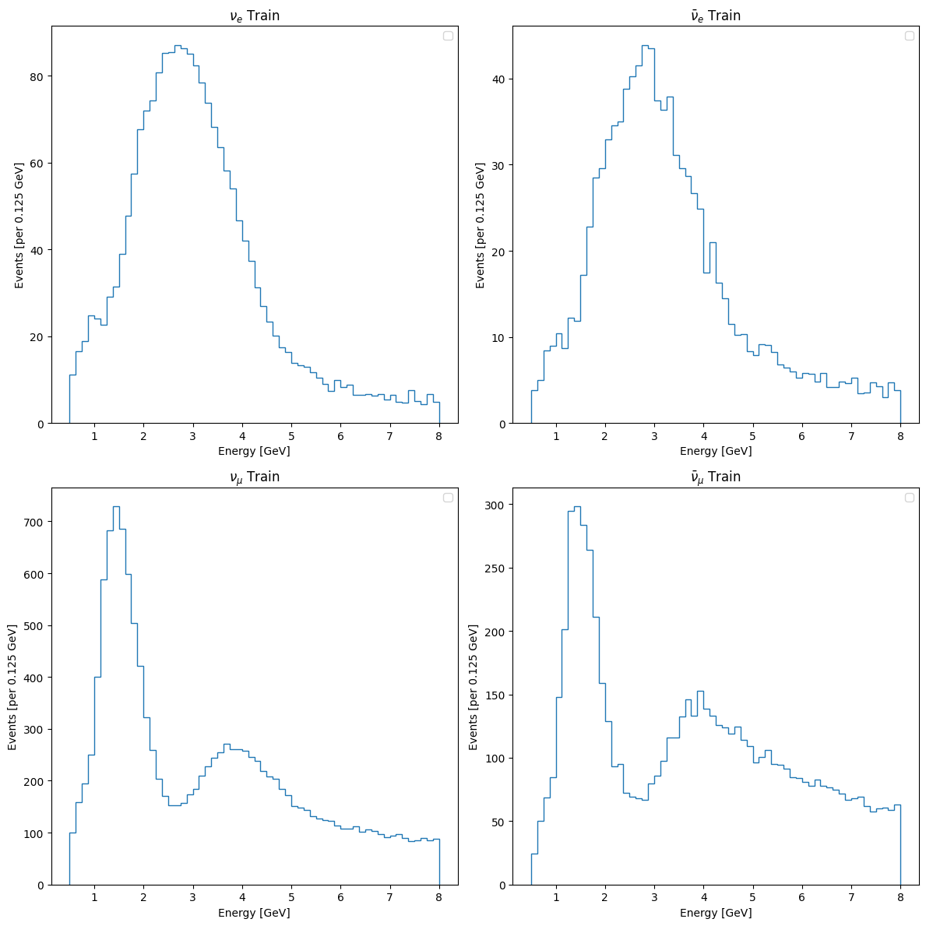
Given Data
Training: ν_{e} energy spectrum ν_{e} energy spectrum ν_{μ} energy spectrum ν_{μ} energy spectrum θ₂₃ δ_{CP}
Testing: ν_{e} energy spectrum ν_{e} energy spectrum ν_{μ} energy spectrum ν_{μ} energy spectrum

Slide 11
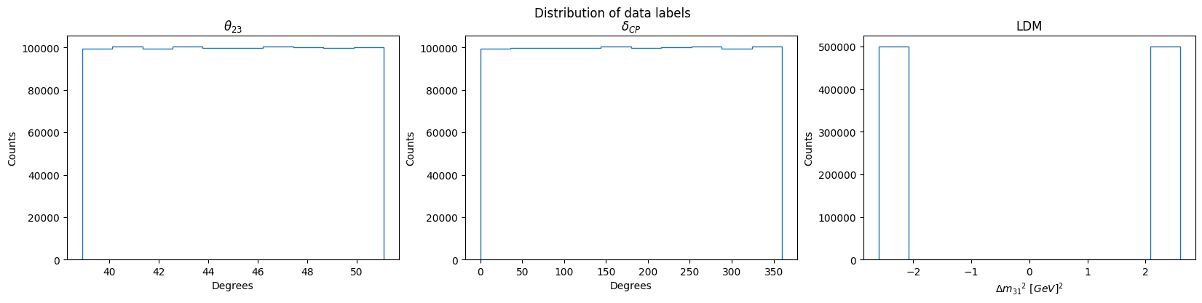
Given Data
Tasked to find the correlation between angles and spectrum plots.
θ₂₃ ranges from approximately 39 to 51 degrees, δ_{CP} ranges from 0 to 360
Immediately noticeable, is the very distinct separation in LDM. One on the positive side, and the other on the negative end. This corresponds to the mass hierarchy mentioned in the referenced literature.
We will make this distinction for all following analysis.

Slide 12
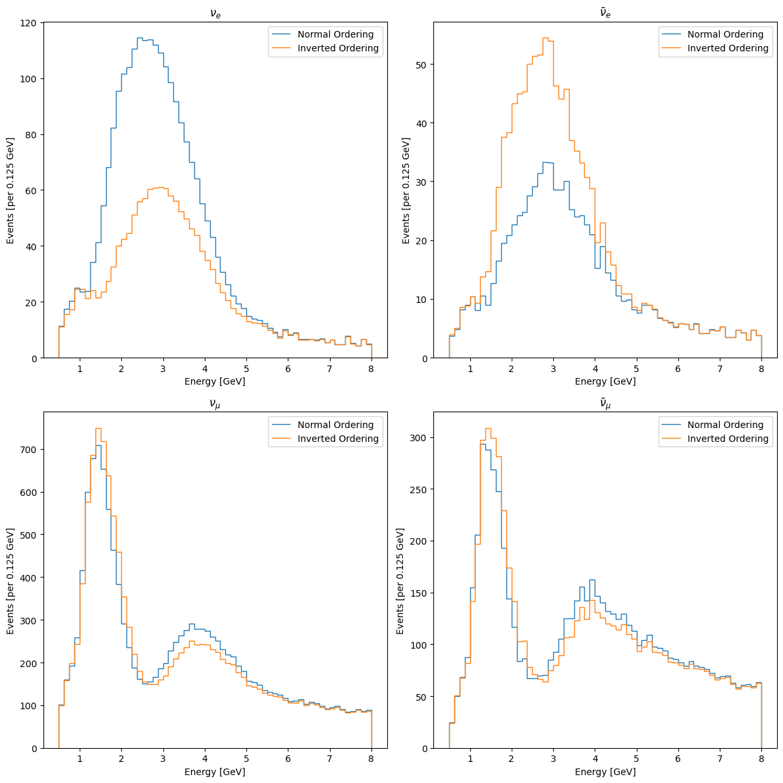
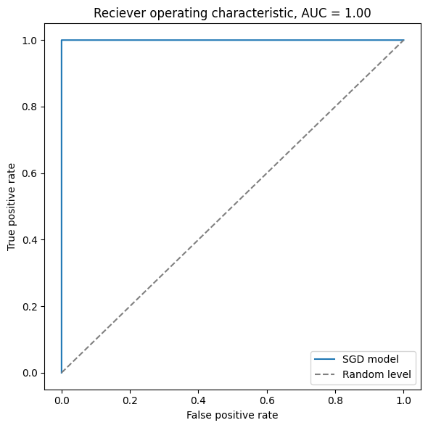
Given Data
Here we plot the averaged spectrum of the normal and inverted ordering data. In the electron neutrino spectrum, we can see a distinct difference in the distribution.
The first model implemented is a support vector machine to make this binary classification.

Slide 13
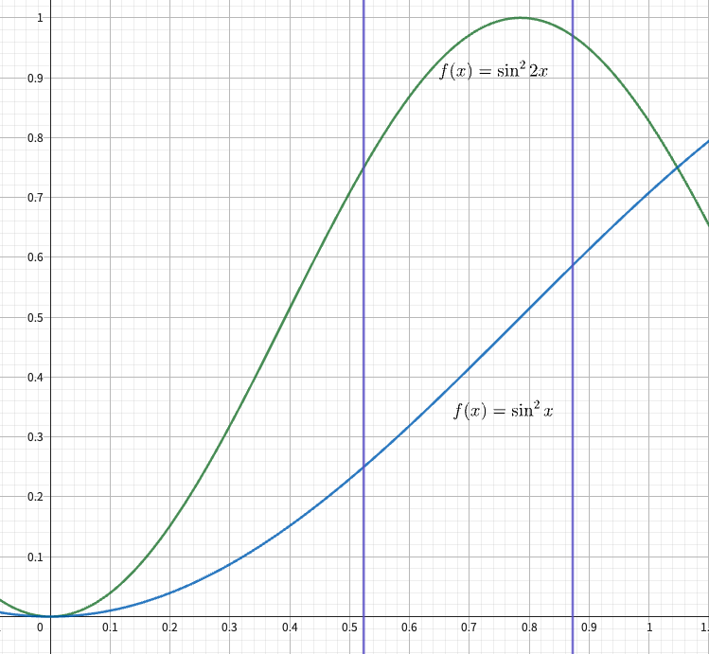
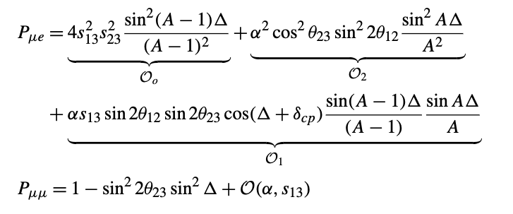
The θ₂₃ mixing angle
Theoretically, θ₂₃ in (with non-trivial leading order): appearance channel: sin² θ₂₃ disappearance channel: sin² 2θ₂₃
In this interval (30 ~ 50 degrees), the probability can be determined, due to the monotonicity of the function (for appearance channels).
Ref: N. Nath, M. Ghosh, and S. Goswami, The Physics of Antineutrinos in DUNE and Determination of Octant and δ_{CP}, Nuclear Physics B 913, 381 (2016).

Slide 14
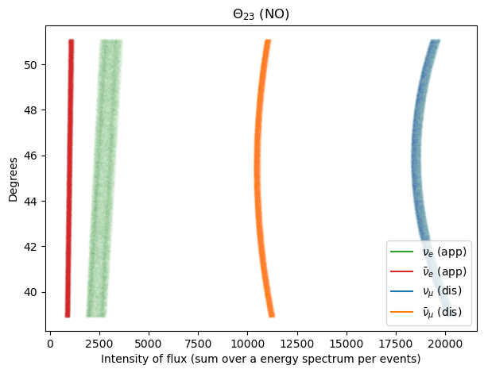
The θ₂₃ Regression
As demonstrated in the formula and this plot, a one-to-many relationship between the total events and θ₂₃ poses as a challenge in the regression task. But not in the appearance channel.
Combining these features, and with aid of machine learning methods, we can expect good predictability in θ₂₃

Slide 15
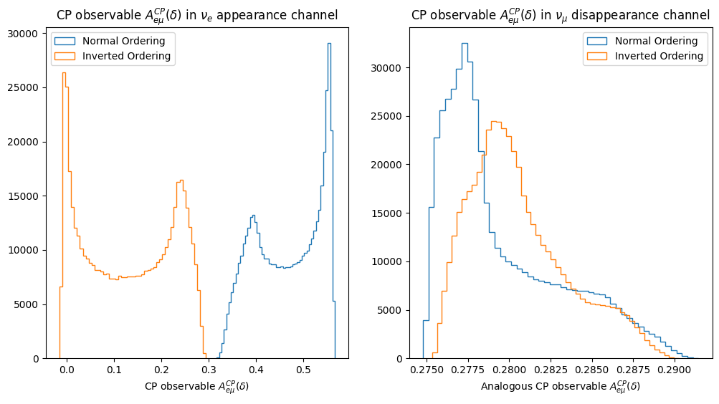
The CP phase and asymmetry observable
As mentioned earlier, the CP phase can be quantified by the level of asymmetry.
Here we present the distribution of CP phase and this observable in both the appearance channel and disappearance channel.

Slide 16
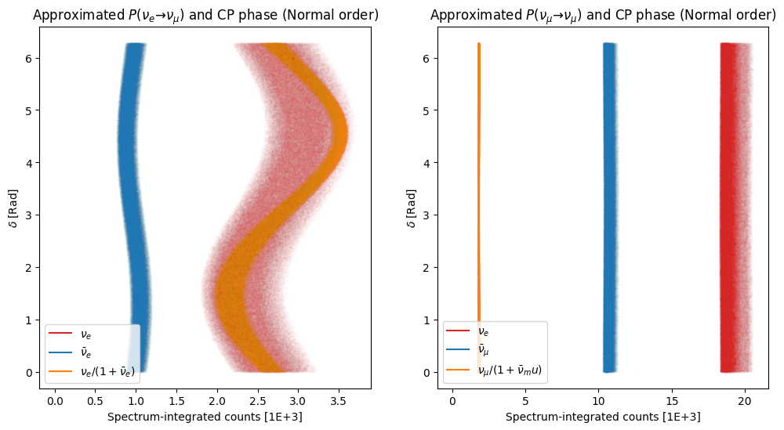
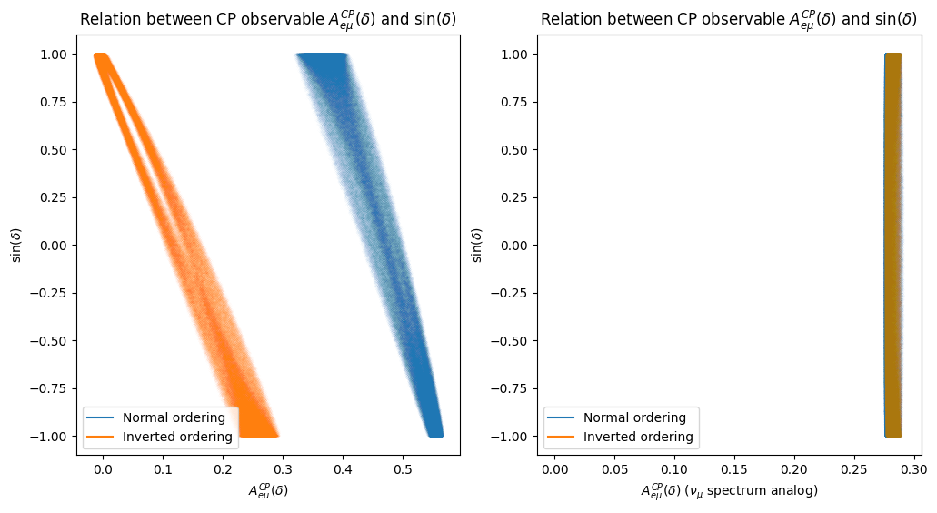
The upper and lower plots present the distribution of CP phase and its relationship with total event counts and the CP asymmetry observable respectively.
Plots of the ν_{e} and ν_{μ} spectrums are on the left and right side respectively.
Our observations show that the event counts in ν_{μ} spectrums are not correlated with the CP phase.

Slide 17
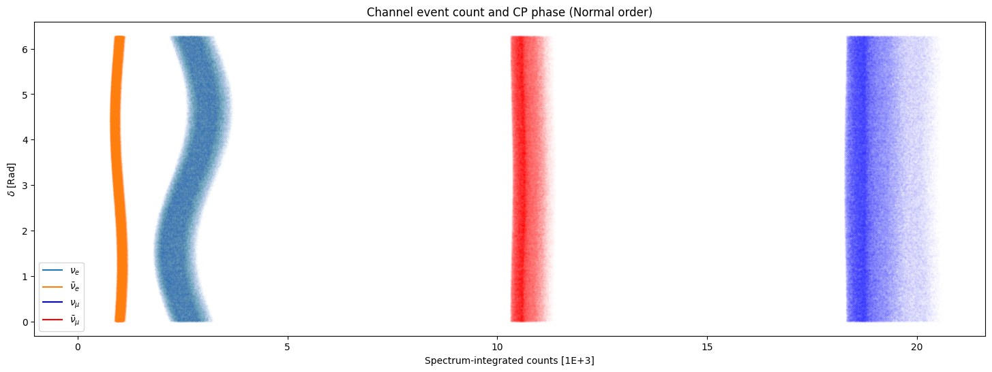
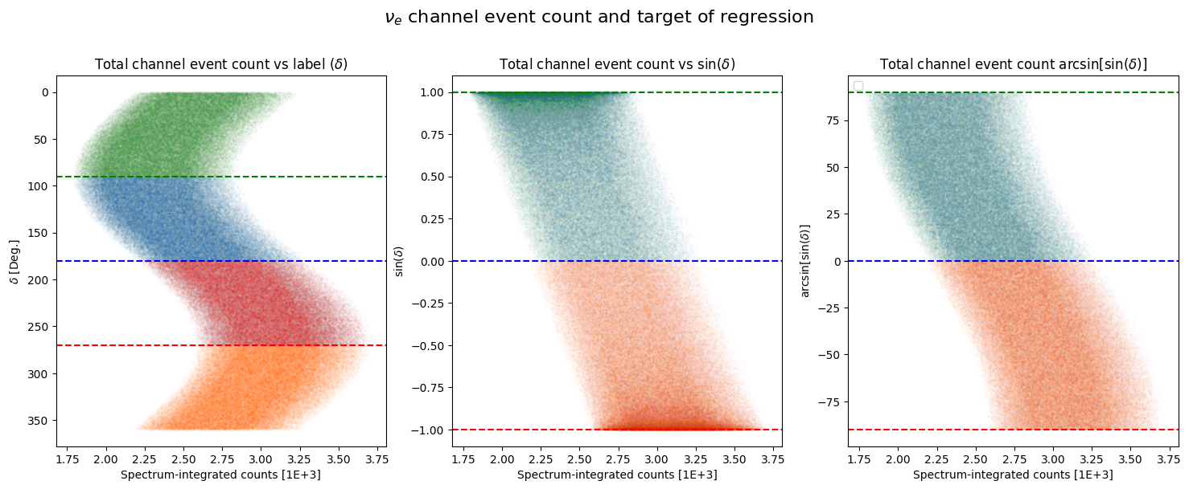

Slide 18
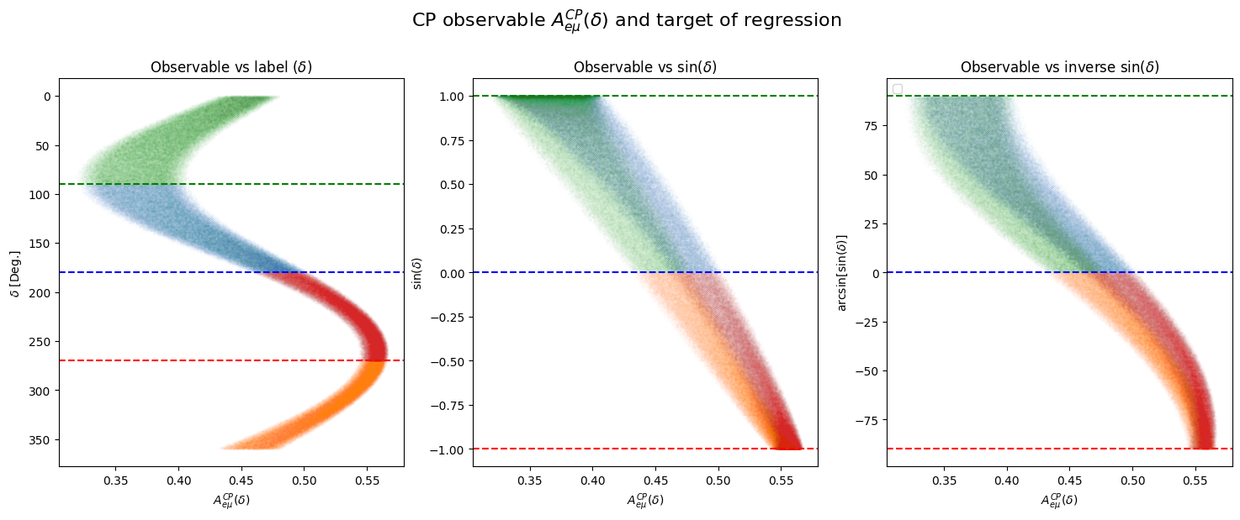
The CP phase Regression
By taking the sine value of the CP phase, we see a clear one-to-one relationship between the asymmetry observable and the sine value.
However, transforming back using the arcsine function will only return values in the interval [-90,90].

Slide 19
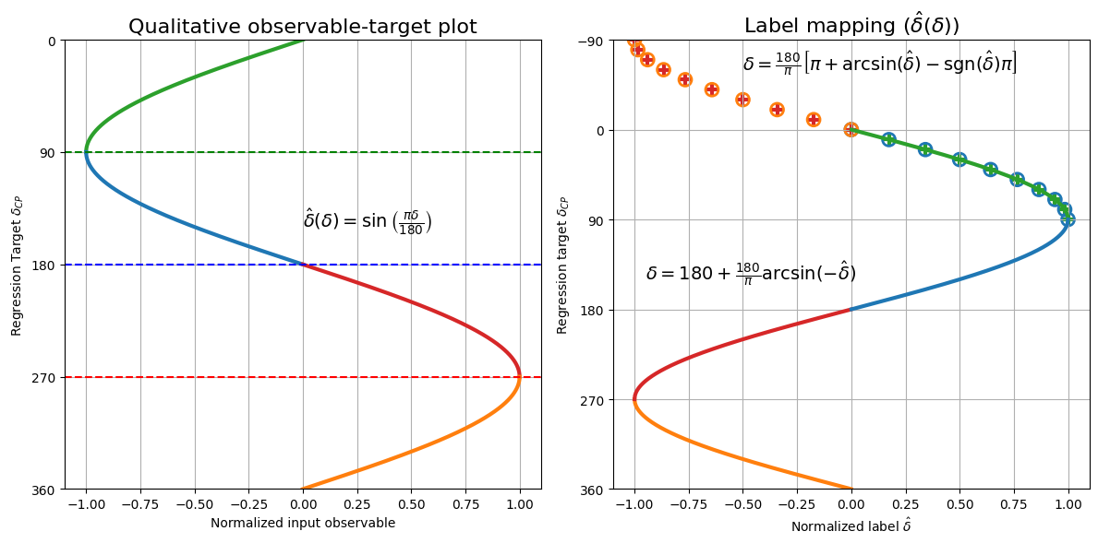
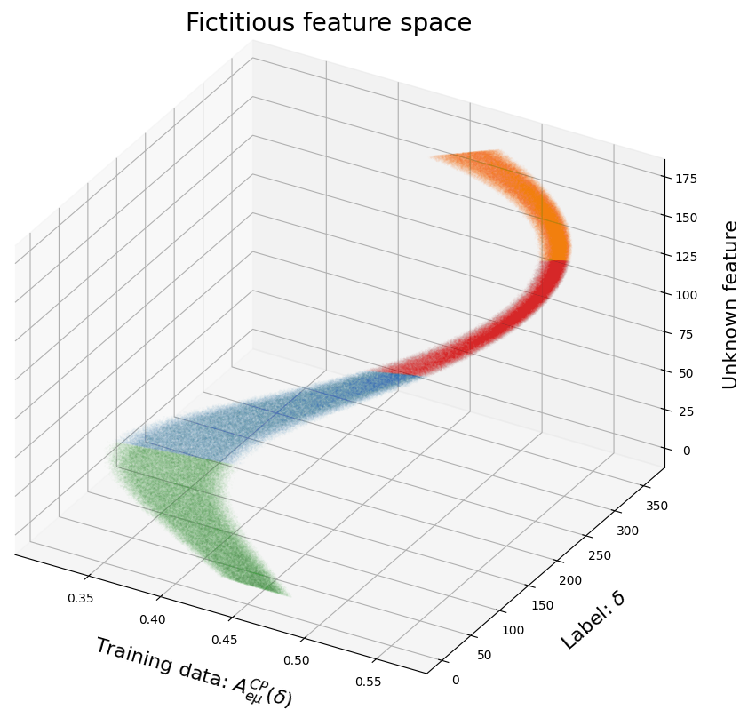
Idealized feature space

Slide 20
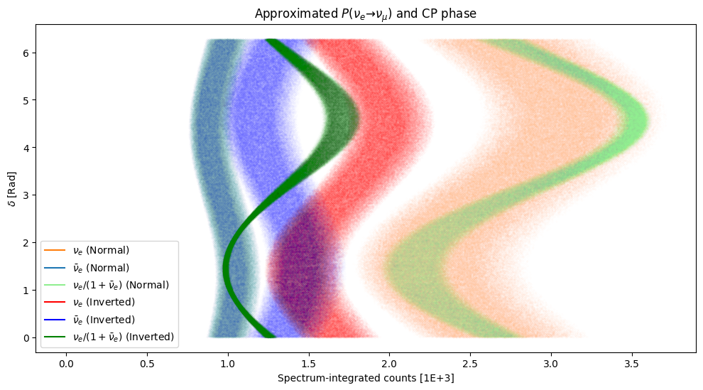
The CP phase Regression

Slide 21
Strategy in CP phase regression
There is more in these spectrum than meets the eye
Our proposed method is to separate this task into three parts:
Part 1: Regression
The aim is to utilize the one-to-one relationship. From the plots, we are confident that the regression to the CP phase sine value should be quite accurate.
Part 2: Classification
The domain of the sine value is between 1 and -1. Which separates the high and low end of the level of asymmetry.
What remains is to perform classification based on the hidden features that allows to separate [0,90] from [90,180], and [180,270] from [270,360]. The classification will help with restoring the actual degree from the arcsine function.

Slide 22
Model architecture
Mass hierarchy identification: (takes one dimensional data)
SVM Binary classifier (using stochastic gradient descent)
θ₂₃ Regression: (takes multi-dimensional data)
A deep convolutional network followed by a multi-layer perceptron.
δ_{CP} Regressor → Classifier
Regression: (Regression takes multi-dimensional data)
Deep convolutional network + multi-layer perceptron
Classification: (takes multi-dimensional data)
Deep convolutional network + multi-layer perceptron
δ_{CP} Classifier → Regressor (in development)
Classification: (takes one dimensional data)
Boosted decision tree (using XGBoost)
Regression: (takes one dimensional data)
Single-layer perceptron

Slide 23
Model architecture
The current model performs regression before classification. The alternate method reverses the two stages.
The Regressor → Classifier model
Relies on the arcsin function, which requires the regression estimate to be very precise and within the [-1,1] interval.
Only two binary classifier models required
The Classifier → Regressor model (in development)
Performs a 4 quadrant classification, which is not easy to achieve
For each class (90 degree quadrants), the corresponding domain no longer overlaps, regression can be directly done on the CP phase in its original degree value (with suitable normalization)
Requires one regressor for each quadrant, though lightweight in comparison, requires individual tuning, which risks overfitting.

Slide 24
BACK UP

Slide 25
Code
General backup repo in GitHub: git@github.com:gary20000915/Neutrino-Oscillation-DUNE.git
Submission backup in Kaggle: https://www.kaggle.com/competitions/phys591000-2023-final-project-i

Slide 26
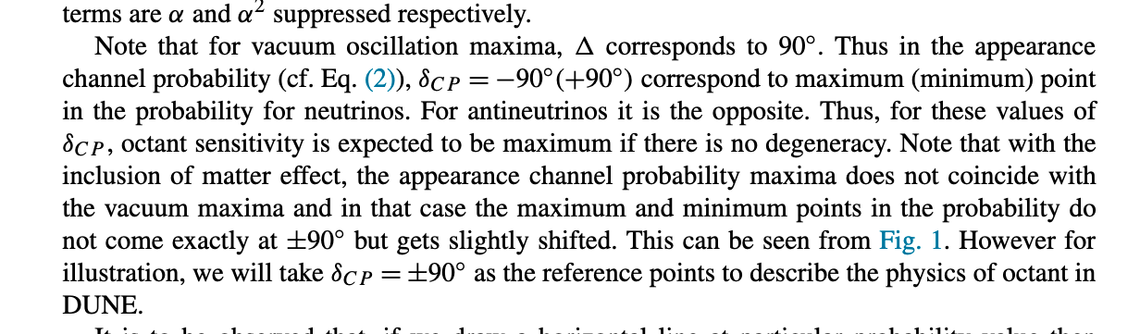
The physics of antineutrinos in DUNE and determination of octant and δ_{CP}
cos(π/2 + δ) = -sin(δ), so this formula is also proportional to sin(δ) if in the vacuum ideal situations. (ref page 386, 387)

Slide 27
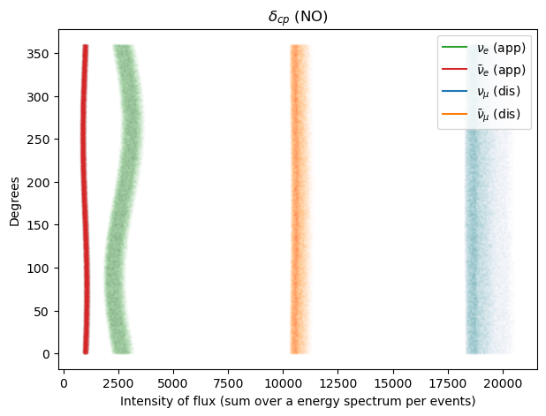
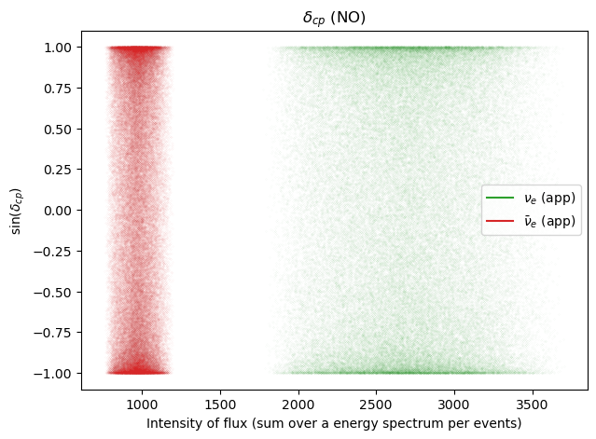
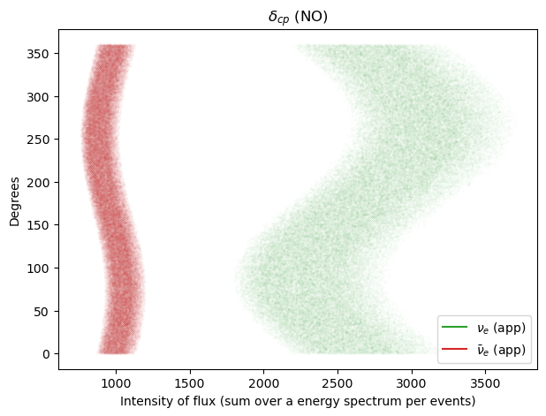
The monotonic relationship is hard to observe with only the channel event count and the sine of CP phase.

Slide 28
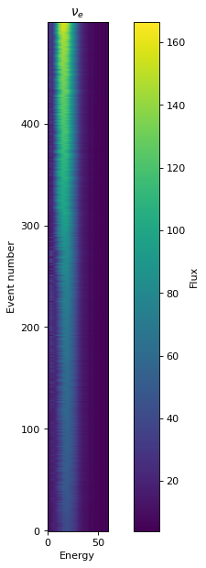
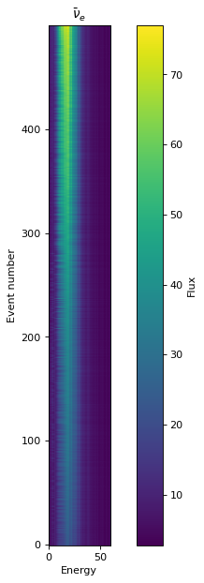
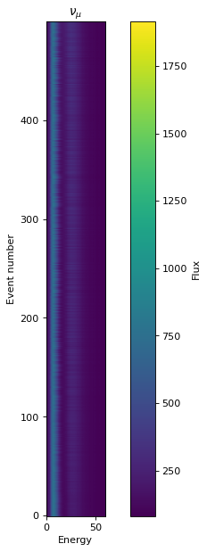
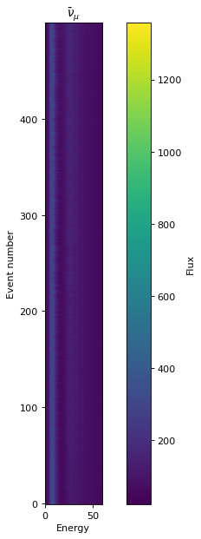

Slide 29
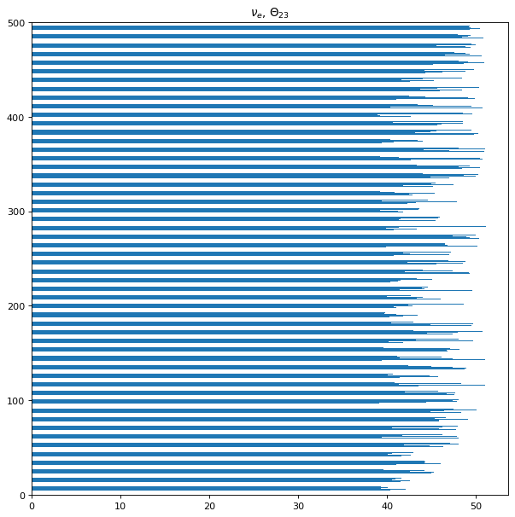
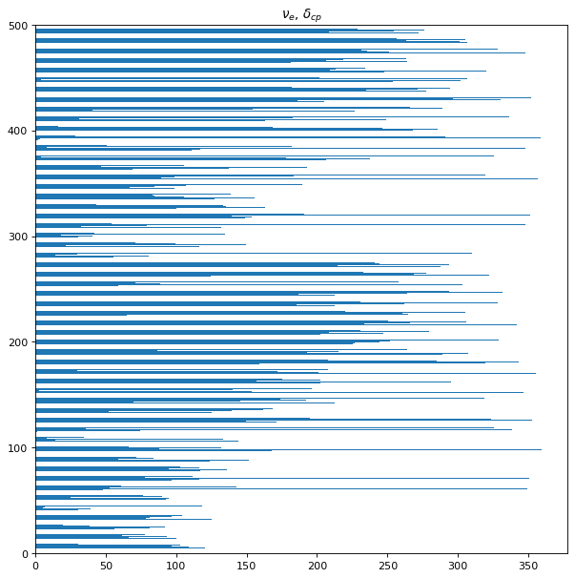
The results are sort by the sum of the specific channel.
(In this page, the y-axis is sorted by the sum of “event number ” by ve channel)

Slide 30
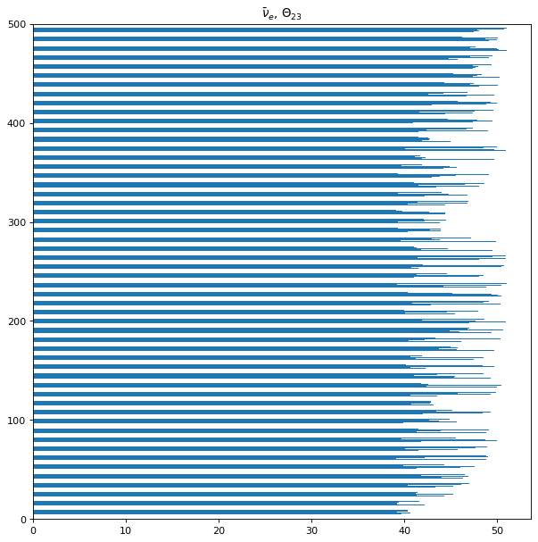
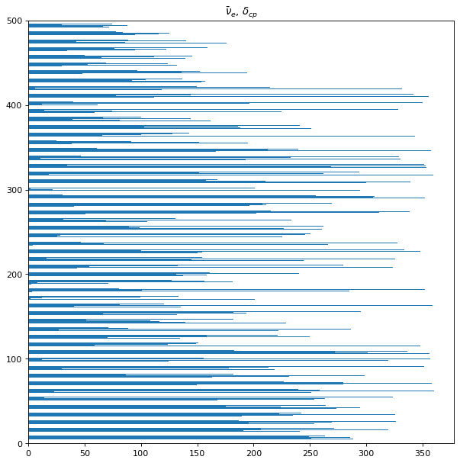

Slide 31
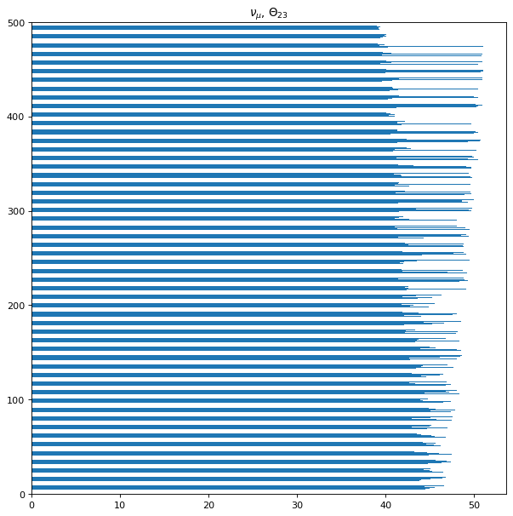
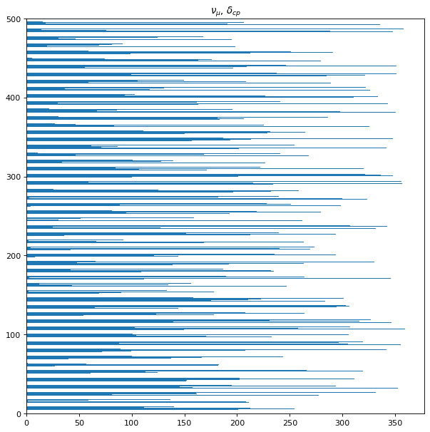

Slide 32
